Slide 1

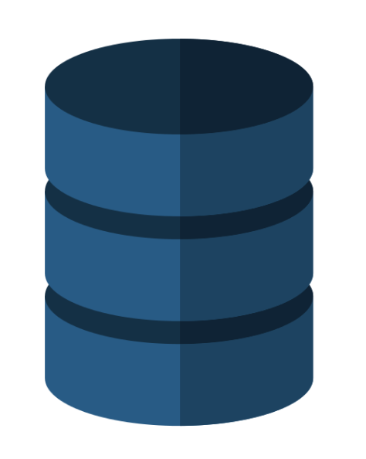
Sharding
husseinnasser.com
Sharding & Consistent Hashing

Slide 2
Agenda
What is sharding?
Consistent Hashing
Horizontal Partitioning vs Sharding
Example (Code with Postgres)
Pros & Cons
Summary

Slide 3

What is Sharding?
URL shortener table with 1 million pages
URL_TABLE
id | Url | urlid*
1 | https://www.canva.com/design/DADrSCuKg4I/5sKekxVdctoGGq7Ri9O5GQ/edit | 5FTOJ
2 | https://en.wikipedia.org/wiki/Shard_(database_architecture)#Database_architecture | CeG0z
.. | …. | ….
.. | …. | ….
1M | https://www.quora.com/How-does-base64-encoding-work | J9COp
SELECT URL
FROM URL_TABLE
WHERE URLID = “5FTOJ“

Slide 4
What is Sharding?
200k
S1
200k
S2
SELECT URL
FROM URL_TABLE
WHERE URLID = “5FTOJ“
Which database server is 5FTOJ in?
Server 3!
Split 1 million rows table into 5 database instances.. Same schema
200k
S3
200k
S4
200k
S5

Slide 5
Consistent Hashing
postgres:5432
Hash(“Input3”)
5434
Hash(“Input1”)
5432
Hash(“Input2”)
5433
postgres:5434
postgres:5433

Slide 6
Consistent Hashing
postgres:5432
Hash(“Input2”)
5433
Hash(“Input3”)
5434
postgres:5434
postgres:5433

Slide 7
Consistent Hashing
postgres:5432
num(“Input2”) % 3
1
+5432
=5433
postgres:5434
postgres:5433

Slide 8
Horizontal Partitioning vs Sharding
HP splits big table into multiple tables in the same database
Sharding splits big table into multiple tables across multiple database servers
HP table name changes (or schema)
Sharding everything is the same but server changes

Slide 9
Example Code with Postgres (Url shortener)
Spin up 3 postgres instances with identical schema
5432, 5433, 5434
Write to the sharded databases.
Reads from the sharded databases.

Slide 10
Pros of Sharding
Scalability
Data
Memory
Security (users can access certain shards)
Optimal and Smaller index size

Slide 11
Cons of Sharding
Complex client (aware of the shard)
Transactions across shards problem
Rollbacks
Schema changes are hard
Joins
Has to be something you know in the query

Slide 12
Summary
What is sharding?
Consistent Hashing
Horizontal Partitioning vs Sharding
Example (Code with Postgres)
Pros & Cons

